Slide 1
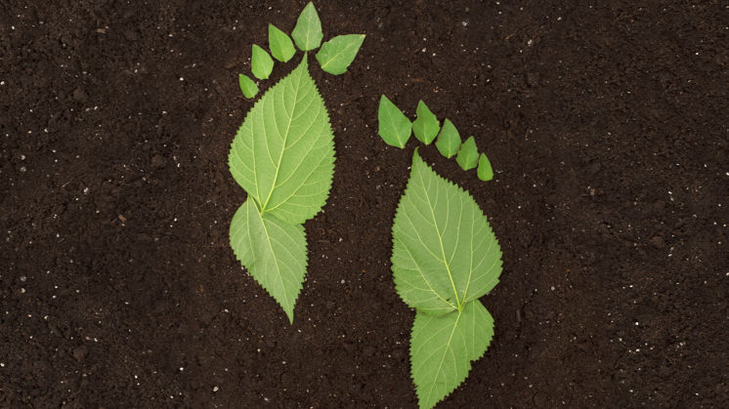
Carbon footprint due to Food Production
By
Sravani Somepalli
MSBA 2022 – UC Irvine, Paul Merage School of Business
President – Merage Analytics Club

Slide 2
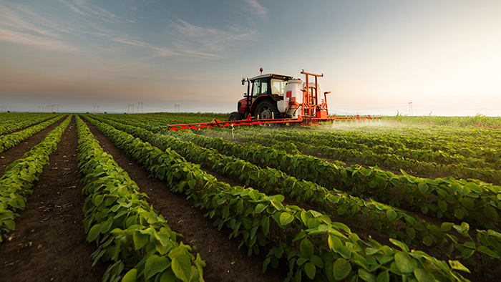
Challenge Statement
We are producing food with all the resources available on earth without being frugal about the usage of the resources. Global food production contributes about 17.3 billion metric tonnes of carbon dioxide equivalent per year.
How can we:
Estimate the current effect of each food.
Evaluate the food production that causing damage in all stages.
Work on the steps to be taken in future.

Slide 3
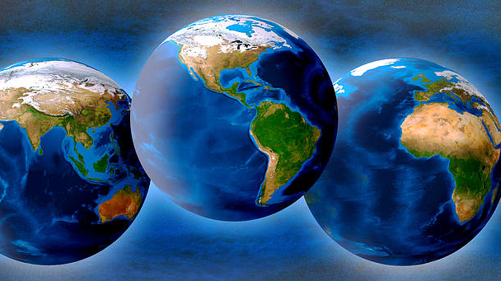
Facts to note
By 2050 we’ll need the equivalent of three planets resources to meet our current needs.
Studies show that food production contributes 37% of world’s greenhouse gas(GHG)

Slide 4
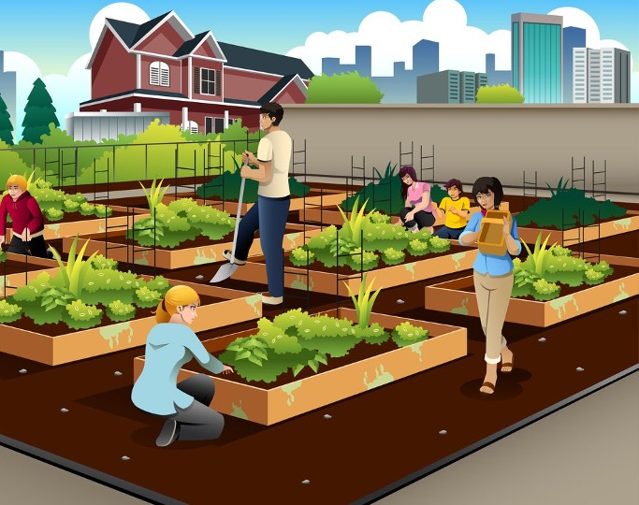
Ways to reduce Carbon footprint
STOP wasting food
Food waste is a major contributor to greenhouse gas emissions. Food that’s thrown away decomposes in landfills and emits methane, a particularly potent greenhouse gas
Fiber-rich foods
Eating more fiber-rich foods not only improves your health but may also reduce your carbon footprint.
A study found that the diets lowest in greenhouse gas emissions were high in fiber-rich plant foods.
Pay attention to disposal/Plastic removal
Garbage disposal has to be taken seriously. Segregating garbage is a lot more important than it’s promoted. Remember lovelace? Avoid single use plastics.
Cut down on meat
Switching to a vegetarian or vegan diet is one of the most effective ways to shrink your food carbon footprint. It is difficult to cut down at once, maybe reducing it to one meal a day.
Purchase Local/Grow your own food
To further cut your food carbon footprint, it would make sense to buy locally grown produce but it’s not that simple. Urban farming is growing very rapidly and encouraging people to grow their own produce in their small places is going to make a real change
Redesign your cooking methods
Numbers show that cooking is responsible for 13.8% of the electricity we use in our homes, so finding more efficient ways to cook means less electricity and, in turn, less CO2 produced.

Slide 5
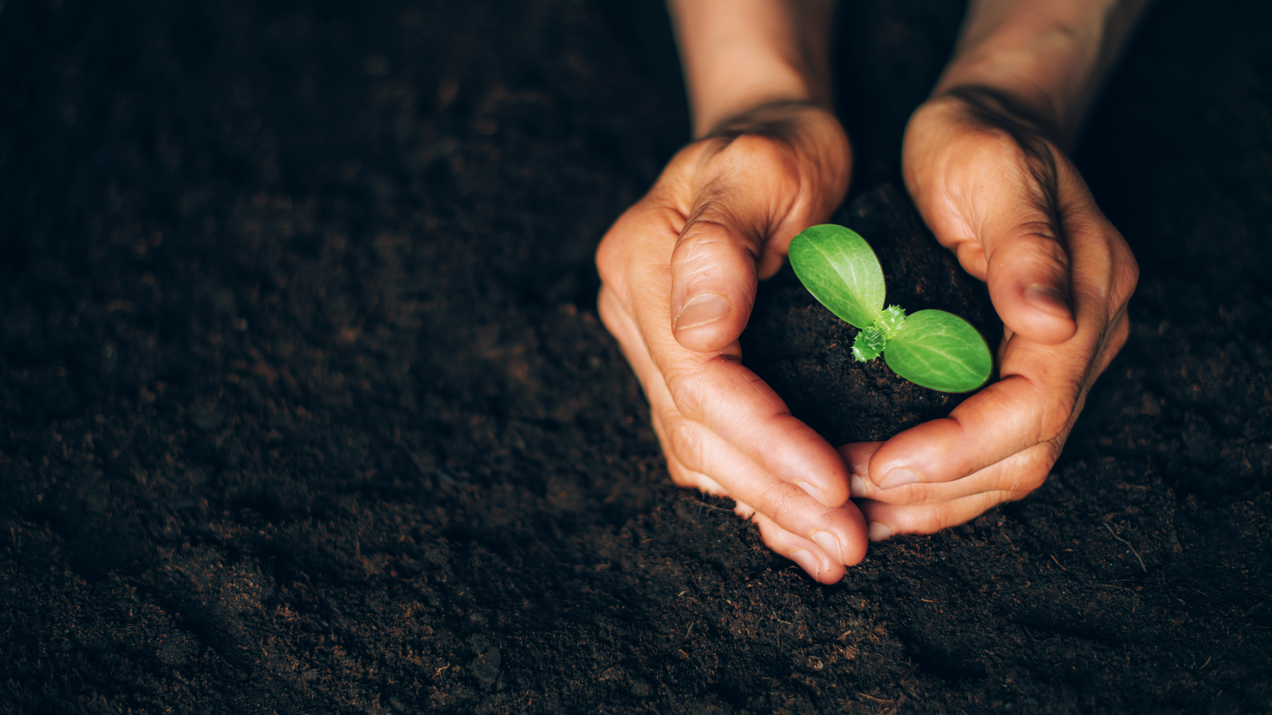
Proposed Solution
Building informative chatbot that brings awareness.
Chatbot contains all the information about the greenhouse emission, eutrophication, land usage and water usage of food items.
Alternative food suggestions that includes sourcing and processing.

Slide 6
Dataset
The data consists of 42 food items and their values used to calculate the carbon footprint.
It includes greenhouse emission values(per kilogram and per 1000kcal)
It includes the land usage and water usage.
Eutrophication values
Scarcity-weighted water usage.

Slide 7

IBM resources used to build the chatbot
IBM Watson assistant – To build the chatbot
IBM Watson discovery – To add the search skills
IBM Functions – Deploy the Python code
Various other IBM resources were used to improve the search and fetch the data from the json file..

Slide 8
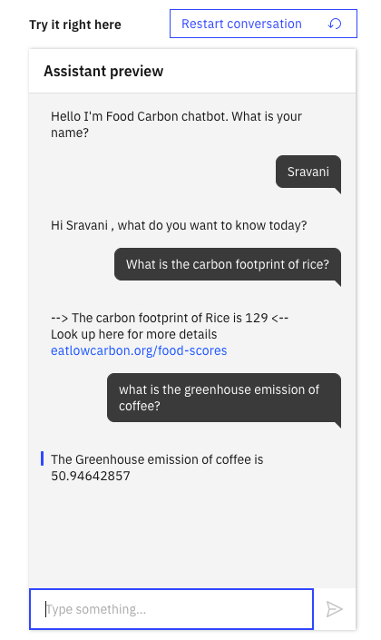
Information Flow
Greenhouse
effect
Eutrophica-tion
Python
Code
IBM Cloud
Function
Watson
Assistant
Land Use
Water Use

Slide 9
Working model
Watson Discovery
Watson Assistant
Search Skill
Intents
Webhook
Dialog nodes
Functions - Actions
Entities
Python/json Code

Slide 10
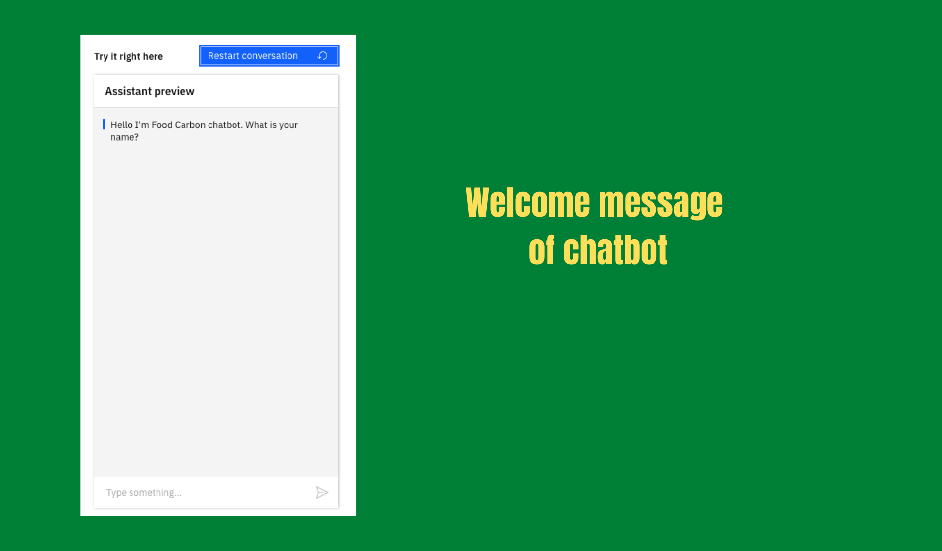

Slide 11
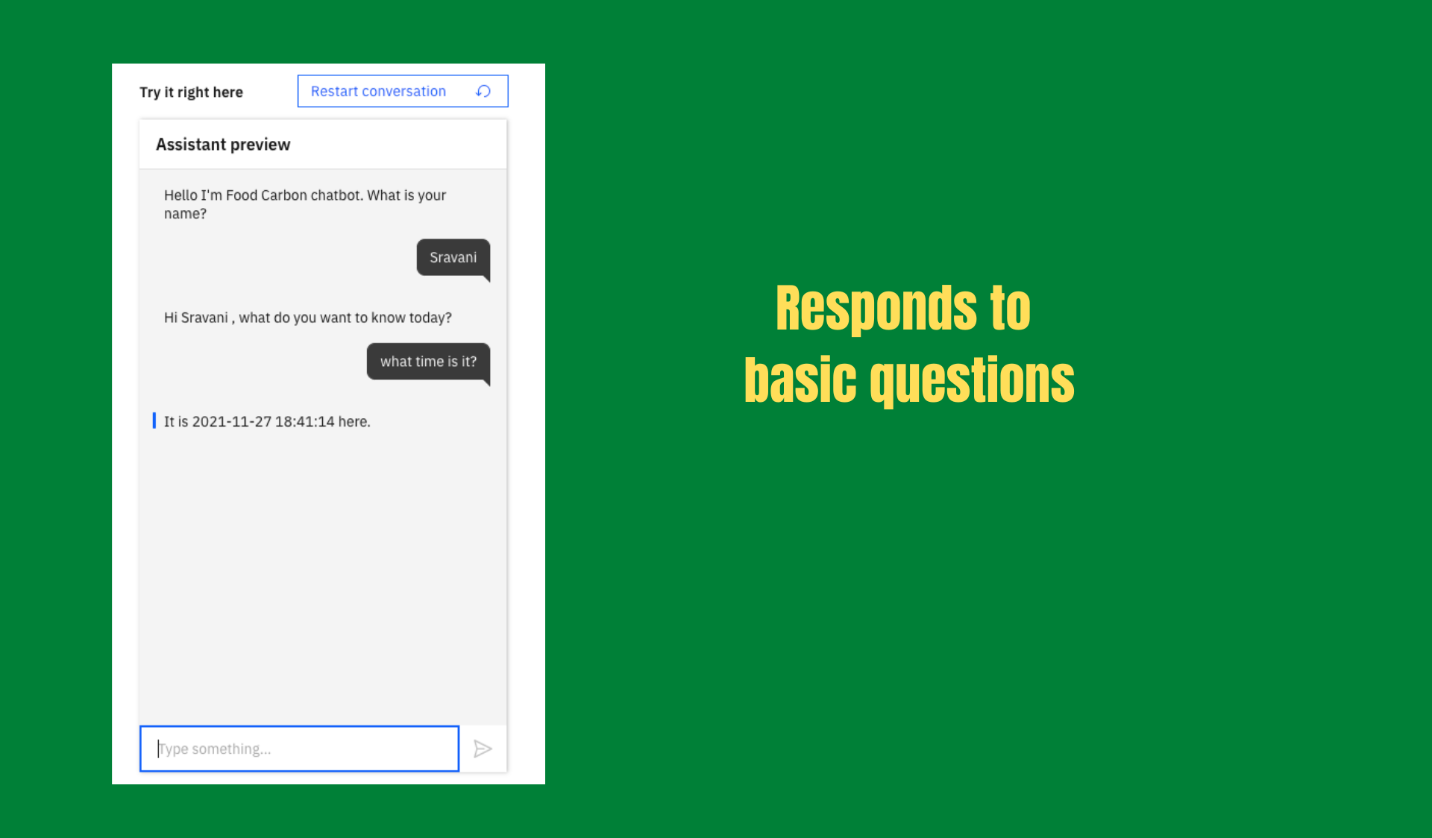

Slide 12
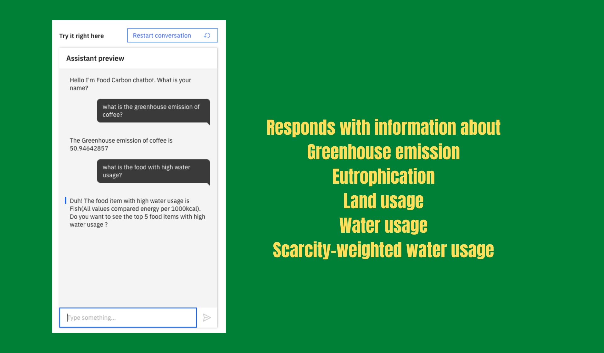

Slide 13
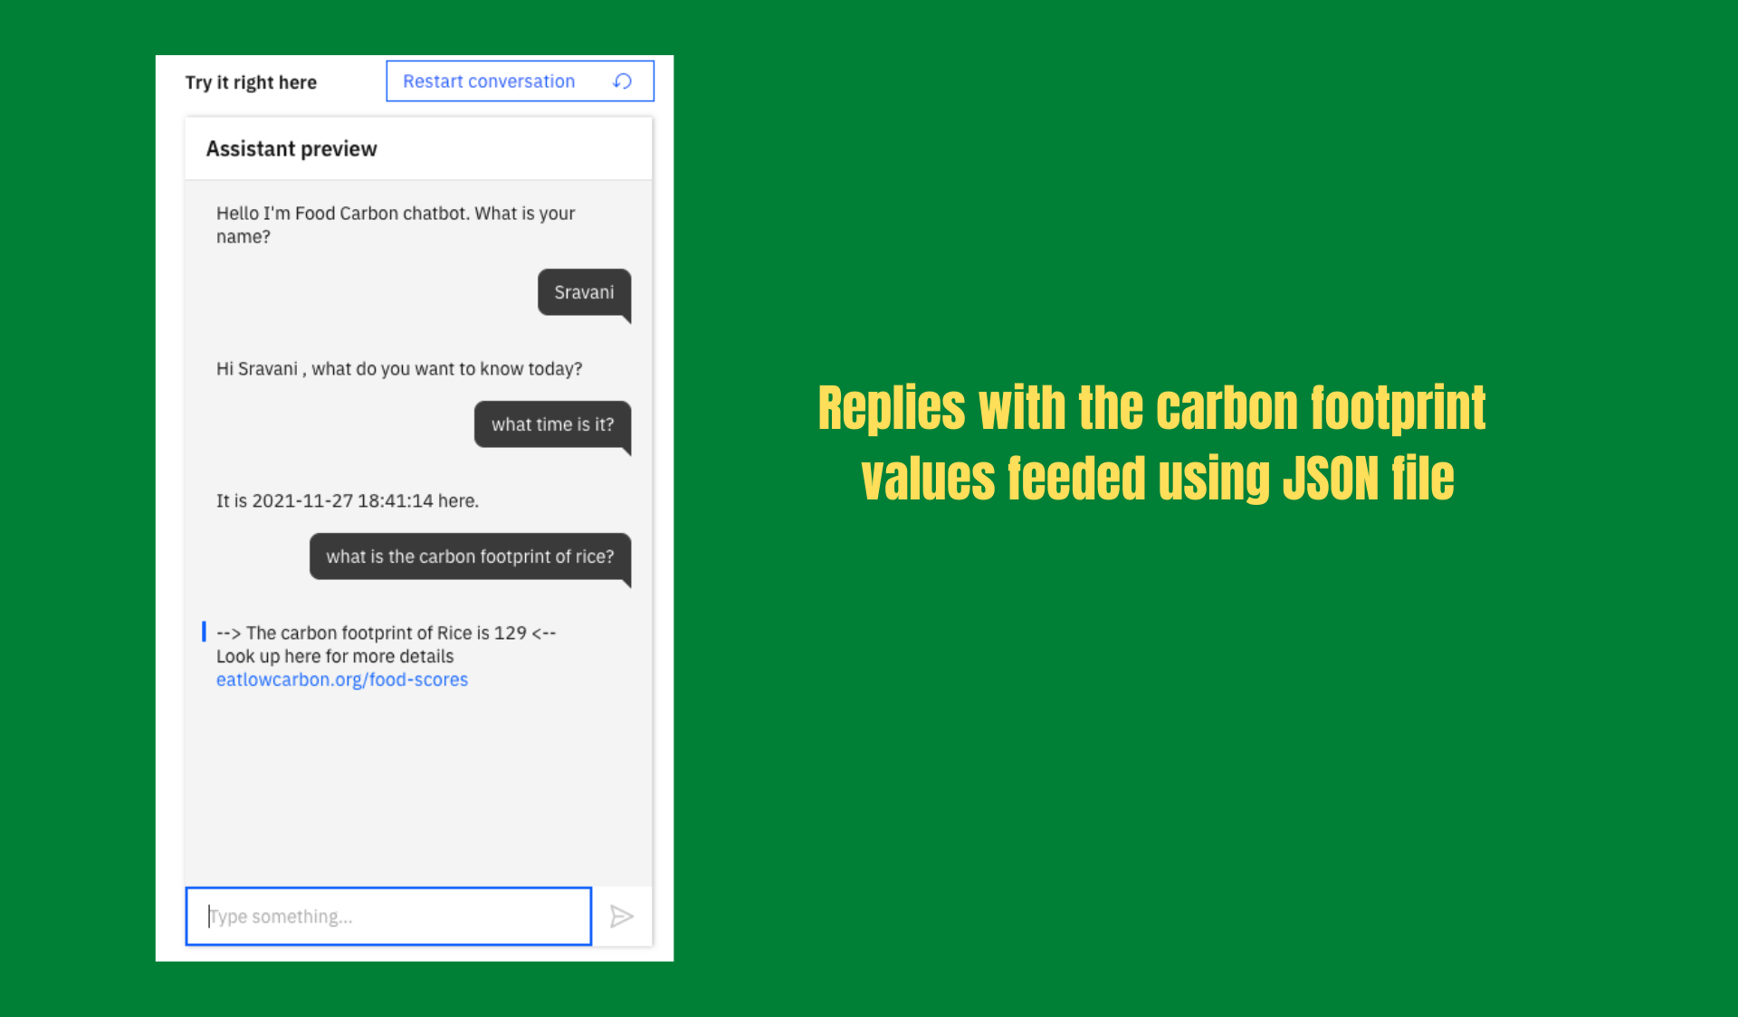

Slide 14
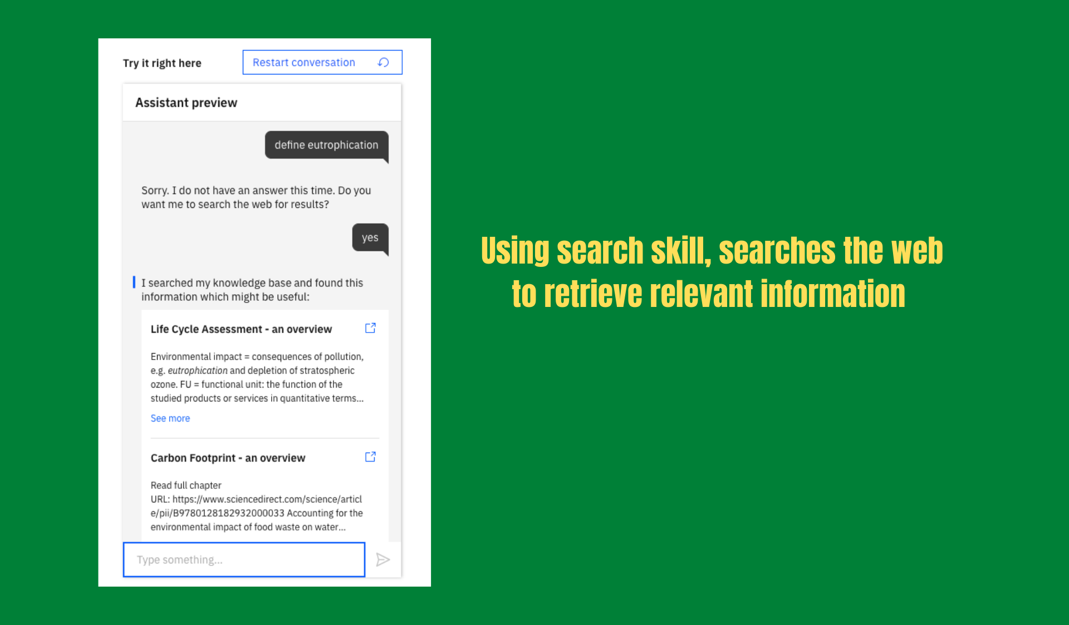

Slide 15
Utterances
What is the greenhouse emission of coffee? | Show me the food with lowest greenhouse emission
What is the food that has highest water usage? | Food distribution emission via Land use change
What percent of Scarcity-weighted water use caused by chocolate? | What is the water usage of Tomatoes?
How much Eutrophication is being caused by cheese? | What is the carbon footprint of Rice?
Define Eutrophication. | What time is it?
I want to see the food distribution by land use | Show me the distribution of water usage Per 1000kcal
Show me top 5 foods with most land usage | Show me the correlation of all stages of supply chain

Slide 16
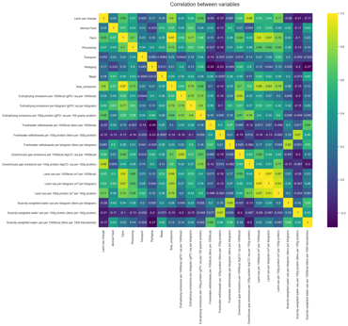
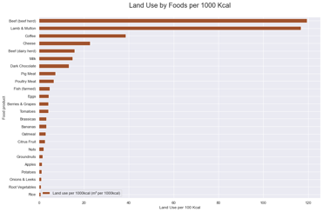
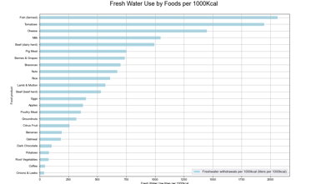
Distribution Charts

Slide 17

Deployment
The chatbot can be integrated to the communication channels like slack for quick access.
It can be integrated with grocery delivery websites to increase the awareness
It can be integrated to smartphones for instant access
The Deployment can be directly done through IBM cloud

Slide 18
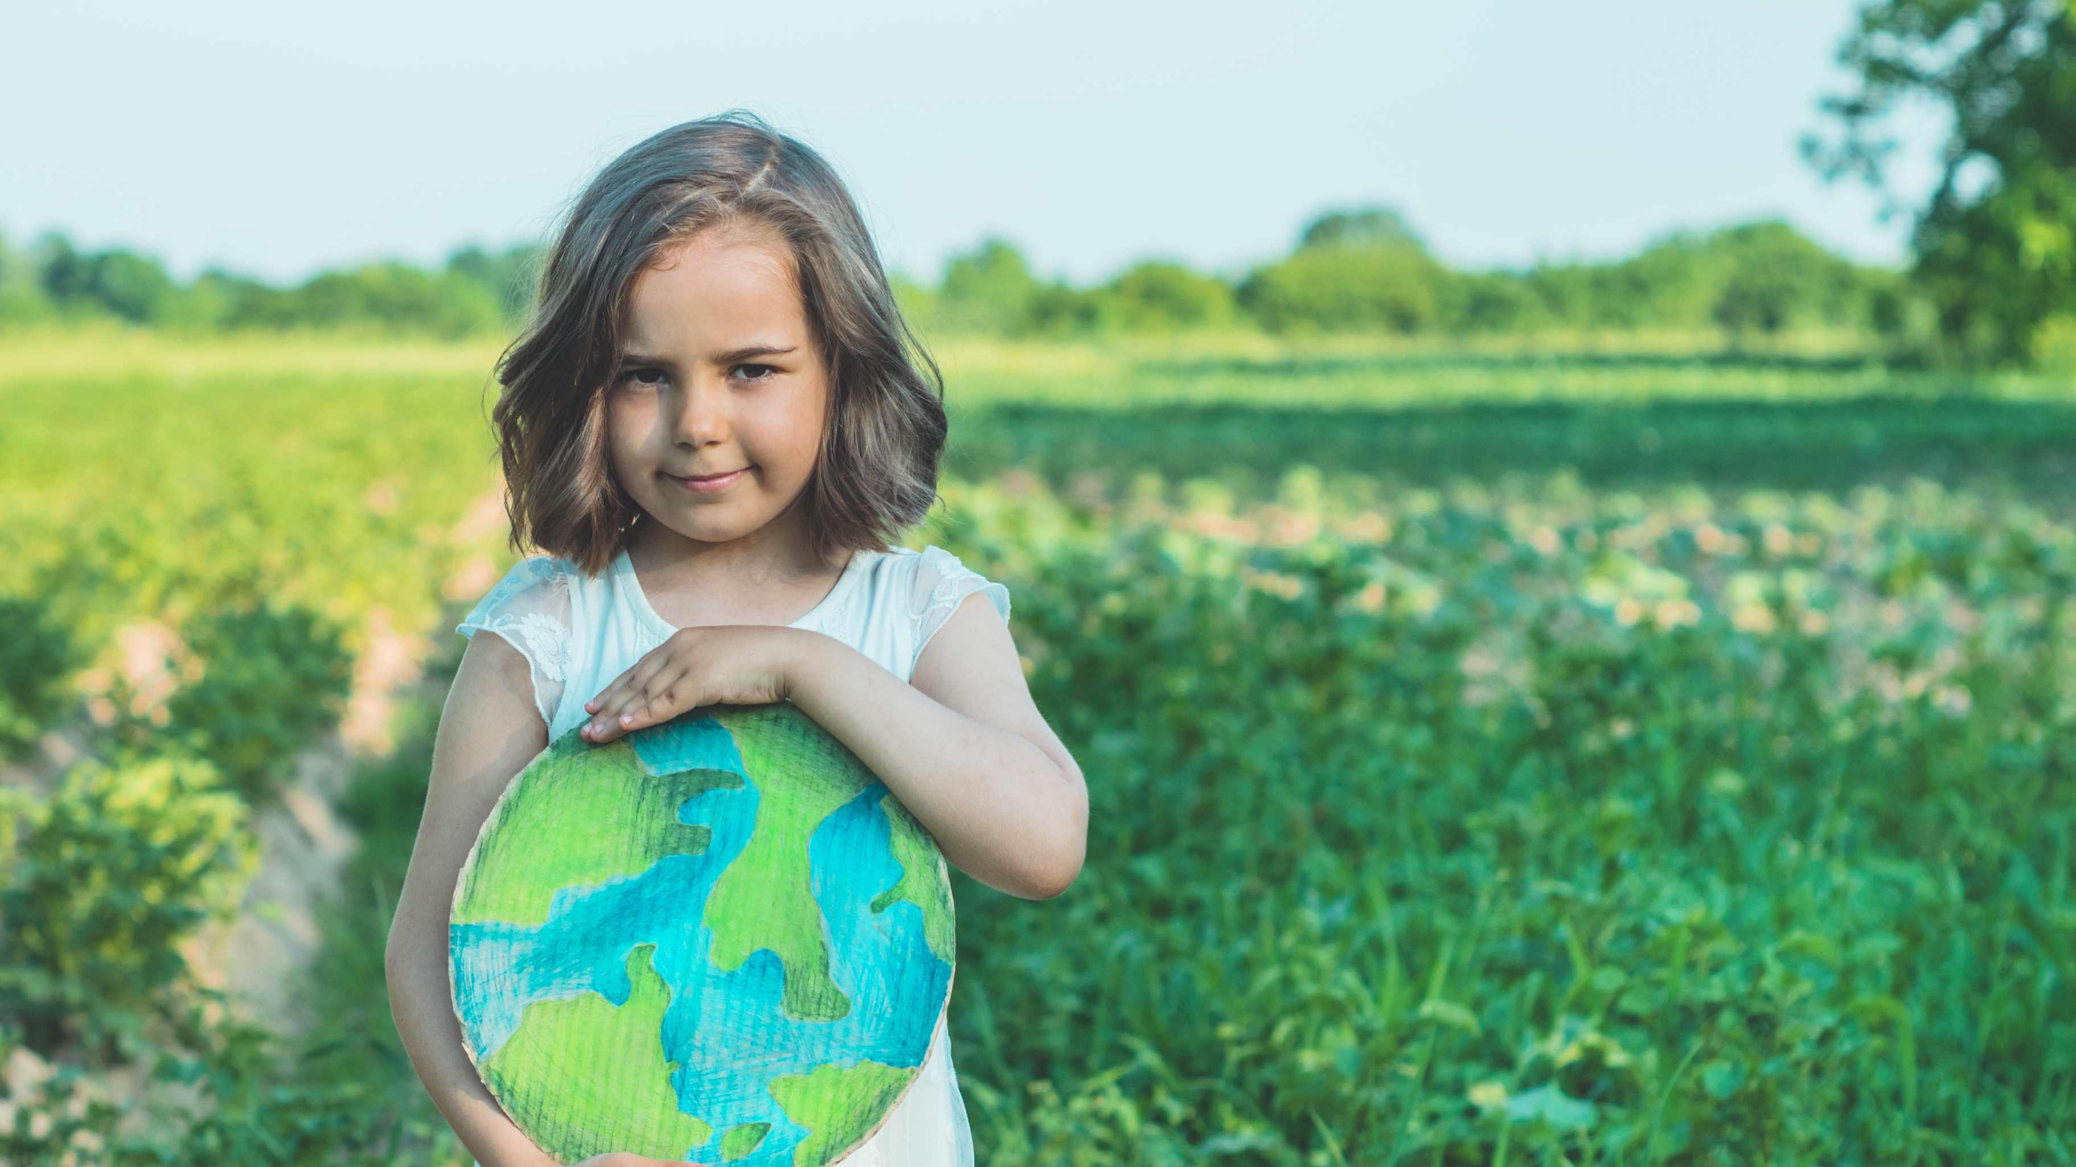
Future Enhancements
The chatbot can be enhanced to suggest eco-friendly alternatives based on picture.
Starting the trend like Snap-Streak. Building weekly strategies that reduce the carbon footprint the most.

Slide 19

Thank You

